Slide 1
AWS CODEPIPELINE

Slide 2
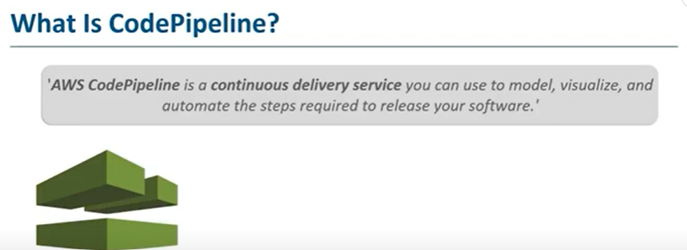
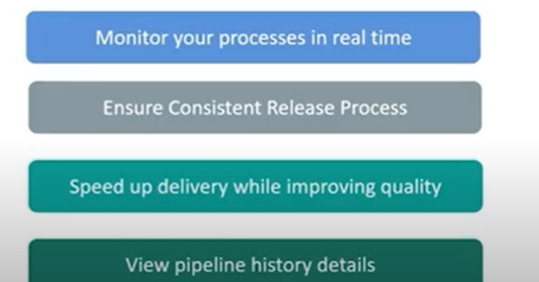

Slide 3
Key Components of AWS CodePipeline
Pipeline: A workflow that defines the release process, consisting of stages.
Stage: A logical phase in the pipeline (e.g., Source, Build, Deploy). Each pipeline must have at least two stages: a source stage and at least one build or deploy stage.
Action: A specific task within a stage (e.g., fetching code, running tests, deploying to an environment).
Artifact: Files (e.g., source code, build output) passed between stages, stored in an Amazon S3 bucket.
Source Provider: Where the code originates (e.g., GitHub, AWS CodeCommit, Amazon S3, Bitbucket).
Triggers: Events that start the pipeline, such as a code commit or manual initiation.

Slide 4
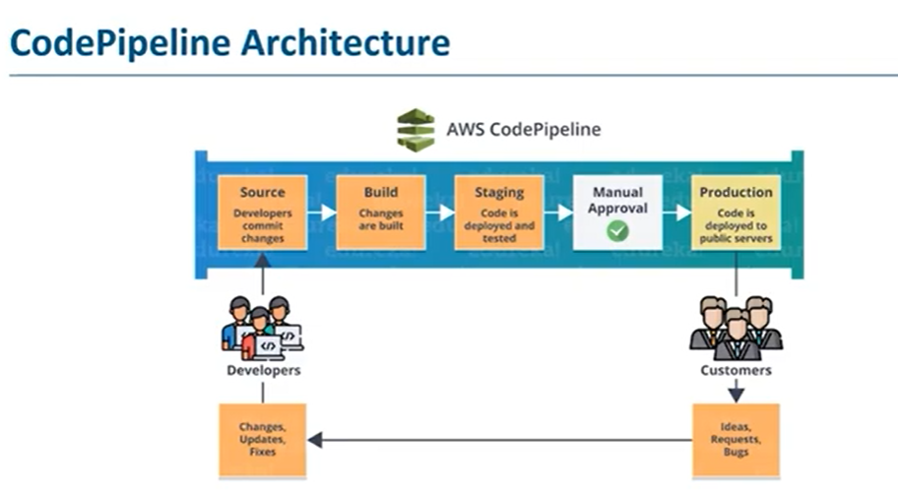

Slide 5
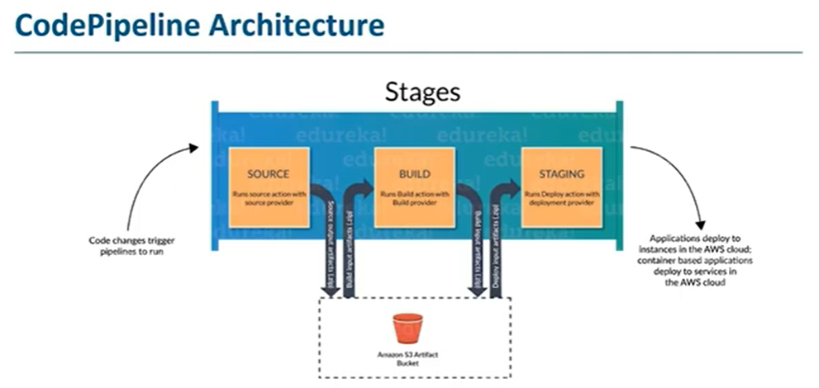

Slide 6
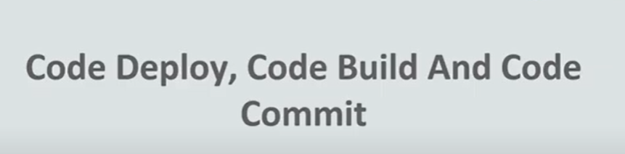

Slide 7
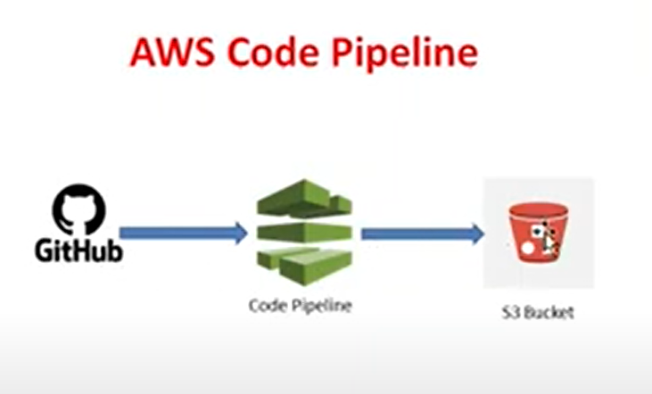

Slide 8
AWS CODE BUILD

Slide 9
What is AWS CodeBuild?
AWS CodeBuild is a fully managed continuous integration (CI) service that compiles source code, runs tests, and produces deployable artifacts. You don’t need to provision or manage servers—it scales automatically.

Slide 10
Build automation: Runs build commands using a buildspec.yml.
Pay-as-you-go: You pay only for the compute time used.
Scalable: Builds run in parallel, no queuing.
Integration: Works seamlessly with CodePipeline, CodeCommit, GitHub, Bitbucket, and S3.
Custom environments: You can bring your own Docker image if the default doesn’t meet requirements.

Slide 11
Source: CodeBuild pulls code from GitHub/CodeCommit/S3.
Build Environment: A container (standard or custom Docker image) is created.
Build Commands: Defined in buildspec.yml (install, build, test, package steps).
Artifacts: Output stored in S3 or pushed to ECR.
Integration: Often linked with CodePipeline for full CI/CD.

Slide 12
AWS CodeDeploy
AWS CodeDeploy is a deployment service that automates application deployments to:
Amazon EC2 instances
On-premises servers
AWS Lambda functions
Amazon ECS services

Slide 13
Key Features
Automated Deployments → No manual steps, fewer errors.
Deployment Strategies:
In-place (stop old version, start new version)
Blue/Green (shift traffic gradually from old to new version)
Rollback: Automatically or manually roll back if deployment fails.
Integration: Works with CodePipeline, GitHub, Bitbucket, Jenkins, etc.
Monitoring: Tied to CloudWatch alarms and AWS Health checks.

Slide 14
Typical Workflow
Source: Code packaged in S3, GitHub, or CodePipeline.
AppSpec File: Defines deployment instructions (appspec.yml or appspec.json).
Deployment Group: A set of targets (EC2, Lambda, or ECS).
Deployment: CodeDeploy agent (for EC2/On-prem) or service (Lambda/ECS) applies changes.
Verification & Rollback: Optional validation tests + rollback on failure.

